Slide 1

Note :
Dear students,
Kindly open this presentation through the PowerPoint application in slideshow mode instead of using simple document or PDF reader. It is advisable to use PowerPoint as the audios inserted for explanation will be audible through it only. You may download the PowerPoint application through Google play store or you may download it by clicking on this link: https://play.google.com/store/apps/details?id=com.microsoft.office.powerpoint&hl=en_US

Slide 2

Importance of International Phonetic Alphabets for learners of
English in India
Dr. Alka Bansal
Head, dept. of English
S.D.(P.G.) College
Muzaffarnagar

Slide 3
What is IPA:
International Phonetic Alphabet (IPA) was developed in the nineteenth century to represent the sounds of languages accurately with the help of a unique symbol for each distinctive sound in a language. Thus, IPA can be called a system for representing phonetic sounds with symbols.

Slide 4
Importance of IPA for Indian learners of English:
IPA is of tremendous significance for the learners of English in India. As we all know that English is the most widely used language in India and is the second language(L2) of most of the Indians. But most of the Indians tend to mispronounce many words, they are also likely to carry over the intonation and phonetics of their mother tongue in English speech.

Slide 5
IPA can help to improve pronunciation:
As English is not a phonetic language, mispronunciation is very common among a good majority of English speakers in India. We usually learn to pronounce words in the same manner as our teachers and elders do. But sometimes its so shocking to discover that the pronunciation of a certain word is so different(according to British R.P.) from what we had been saying throughout our lives. For example, the word hyperbole - /hɑipɜ:bəli/ is mispronounced as /hɑipəbəul/.

Slide 6
Why know IPA:
There are 26 Alphabets in English but they do not represent all sounds. One letter may produce different sounds in different words. For e.g. mat/mæt/, car/kɑ:/. See the different ways in which the letter ‘e’ is pronounced in the word ‘re-entered’, it has four different pronunciations including one silent letter - /ri:entəd/ - /i:/,/e/, silent, /ə/. Sometimes we come across words that are spelled differently but pronounced in the same manner. For e.g. Pair - /peə/
Pear - /peə/
Hair - /heə/
Hare - /heə/

Slide 7
Since, there is no one to one relationship between the letters of the alphabets and the sounds they represent, we need a different notation in which one symbol represents one sound. As per an estimate eighty percent of English words are not spelled phonetically. So, the Indian learners get confused especially those who have Hindi as L1 (mother tongue) because Hindi is hundred percent phonetic. Hence, IPA serves as an excellent pronunciation tool for the learners of English in India.
It helps the learners of English to know exactly which sound to articulate. But for this the learners should be aware of the phonetic symbols and the sounds which the symbols represent.

Slide 8
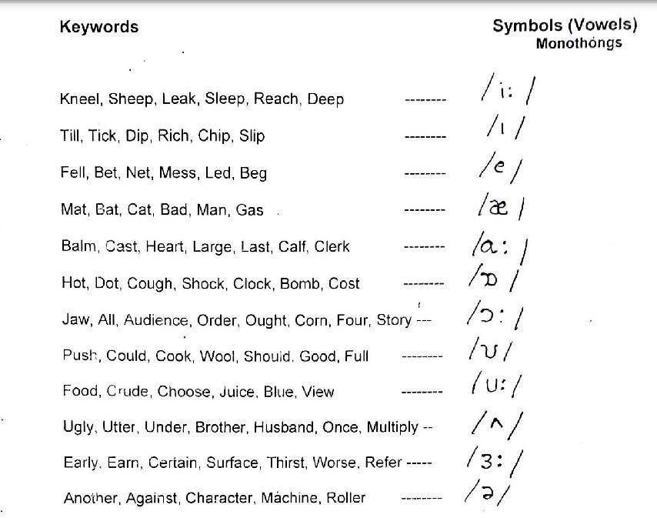
Phonetic Symbols:
Here is the list of phonetic symbols along with the keywords. These keywords have the sound which the symbol represents. It helps the learners to comprehend the sound which the symbol stands for.

Slide 9
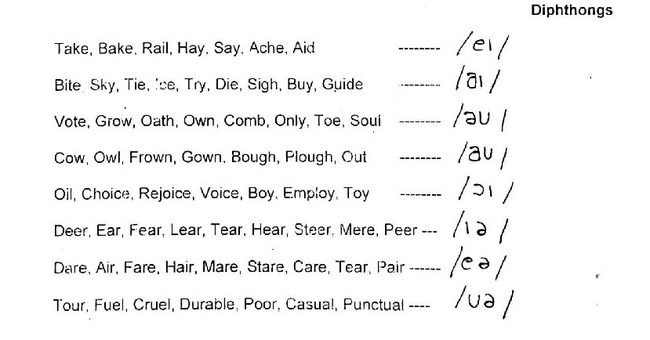

Slide 10
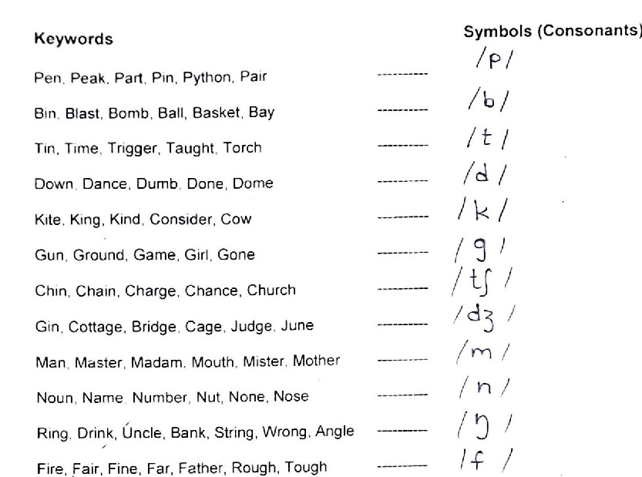
In consonant sounds there are 3 nasal sounds/m/, /n/, /ŋ/, all other sounds are oral.
But sometimes some people tend to speak all consonant sounds as nasal sounds that is they are hyper nasal. Technically, this condition is called Rhinolalia Aperta.
And there are some speakers who do not articulate the nasal sounds at all. This condition is called Rhinolalia Clausa.

Slide 11
