Slide 1
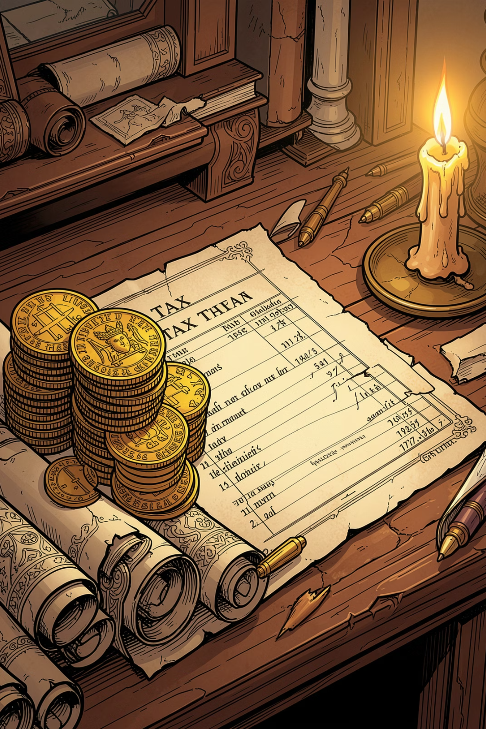
General Theories and Principles of Taxation
Dr. Anoop Patel
Assistant Professor
Department of Commerce
S D College, Muzaffarnagar

Slide 2

Introduction to Taxation
Taxation is one of the oldest instruments of government finance, dating back to ancient civilizations. Over centuries, it has evolved alongside social, political, and economic change — adapting to meet the needs of societies across the globe.
Ancient Roots
Political Evolution
Tax systems in Egypt, Mesopotamia, Greece, Rome, and India funded empires and public works
Shifted from arbitrary royal levies to structured, legally mandated contributions
Economic Theory
Philosophers and economists developed frameworks to justify fair tax collection and distribution

Slide 3
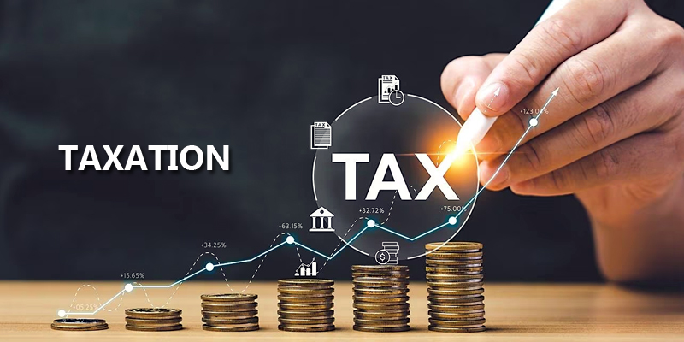
What Is Taxation?
Definition
A compulsory contribution by individuals and businesses to the government — mandated by law, not voluntary. Taxation forms the backbone of public finance.
Core Purpose
To finance public expenditure and welfare programs, enabling governments to provide essential services and maintain societal infrastructure.
Key Uses of Tax Revenue
Defense and public administration
Infrastructure development
Education and healthcare systems
Social welfare programs
Economic stability measures

Slide 4
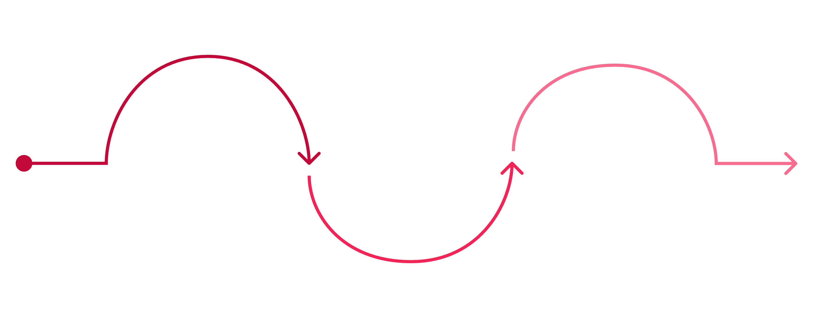
Historical Evolution of Taxation
Taxation has transformed across three major eras — from in-kind tributes in ancient empires, through arbitrary feudal levies, to systematic principles under modern capitalism.
Ancient Period
Classical & Modern
In-kind taxes: grain, cattle, gold, labor
Canons, progressive tax, welfare, digital GST
Medieval Period
Arbitrary levies by kings and feudal lords
Each era reflects broader shifts in governance, economic structure, and social contract between rulers and the ruled.

Slide 5




The Ancient Period
"Collect taxes like a bee collects honey — without harming the flower." — Kautilya, Arthashastra, Ancient India
In-Kind Payments
Taxes collected as grains, cattle, gold, or labor — not currency — across Egypt, Mesopotamia, Greece, Rome, and India
Funding Empires
Revenue sustained military campaigns, monumental architecture, irrigation systems, and centralized administration
Early Principles
Kautilya's Arthashastra articulated one of the first systematic frameworks for equitable and sustainable revenue collection

Slide 6

The Medieval Period
Arbitrary Rule
Kings and feudal lords imposed heavy, often capricious taxes — including land taxes, trade duties, and religious tithes — without standardized legal frameworks.
Mughal Revenue Systems
The Mughal Empire introduced Zabti (land measurement-based assessment) and Jagirdari (land grants to revenue collectors), pioneering more systematic approaches.
Structural Failures
Excessive burden on peasants and common people
Unfair distribution of tax obligations
Lack of standardization enabling local exploitation

Slide 7

The Classical Period
The 17th–18th centuries marked a pivotal shift in taxation theory. With the rise of capitalism and nation-states, systematic approaches replaced arbitrary levies. Adam Smith's Wealth of Nations (1776) introduced the Canons of Taxation — foundational principles that continue to guide modern tax policy worldwide.
From Arbitrary to Systematic
Taxation became a subject of rigorous economic analysis, grounded in fairness, efficiency, and legal certainty
Adam Smith's Legacy
His four canons — Equality, Certainty, Convenience, and Economy — remain the gold standard for evaluating tax systems

Slide 8
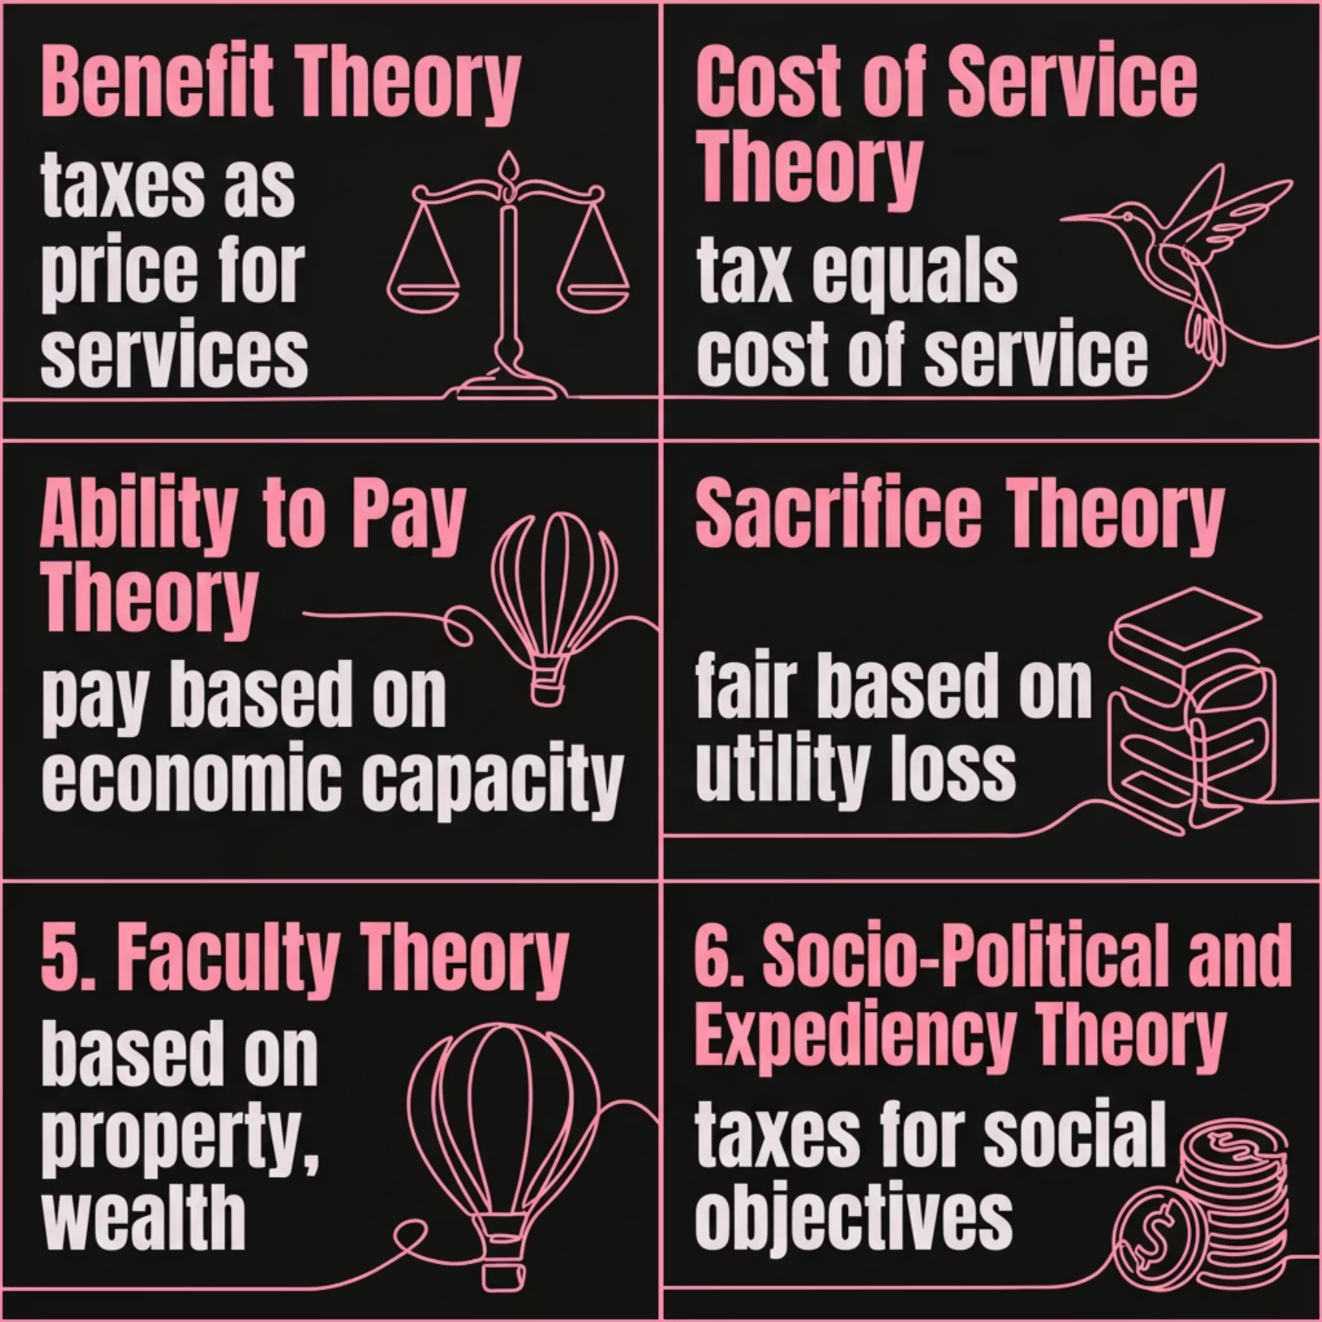

Major Theories of Taxation
Scholars and economists have developed multiple theoretical frameworks to justify who should be taxed and how much. Each theory reflects a different conception of fairness, social obligation, and the role of the state.

Slide 9
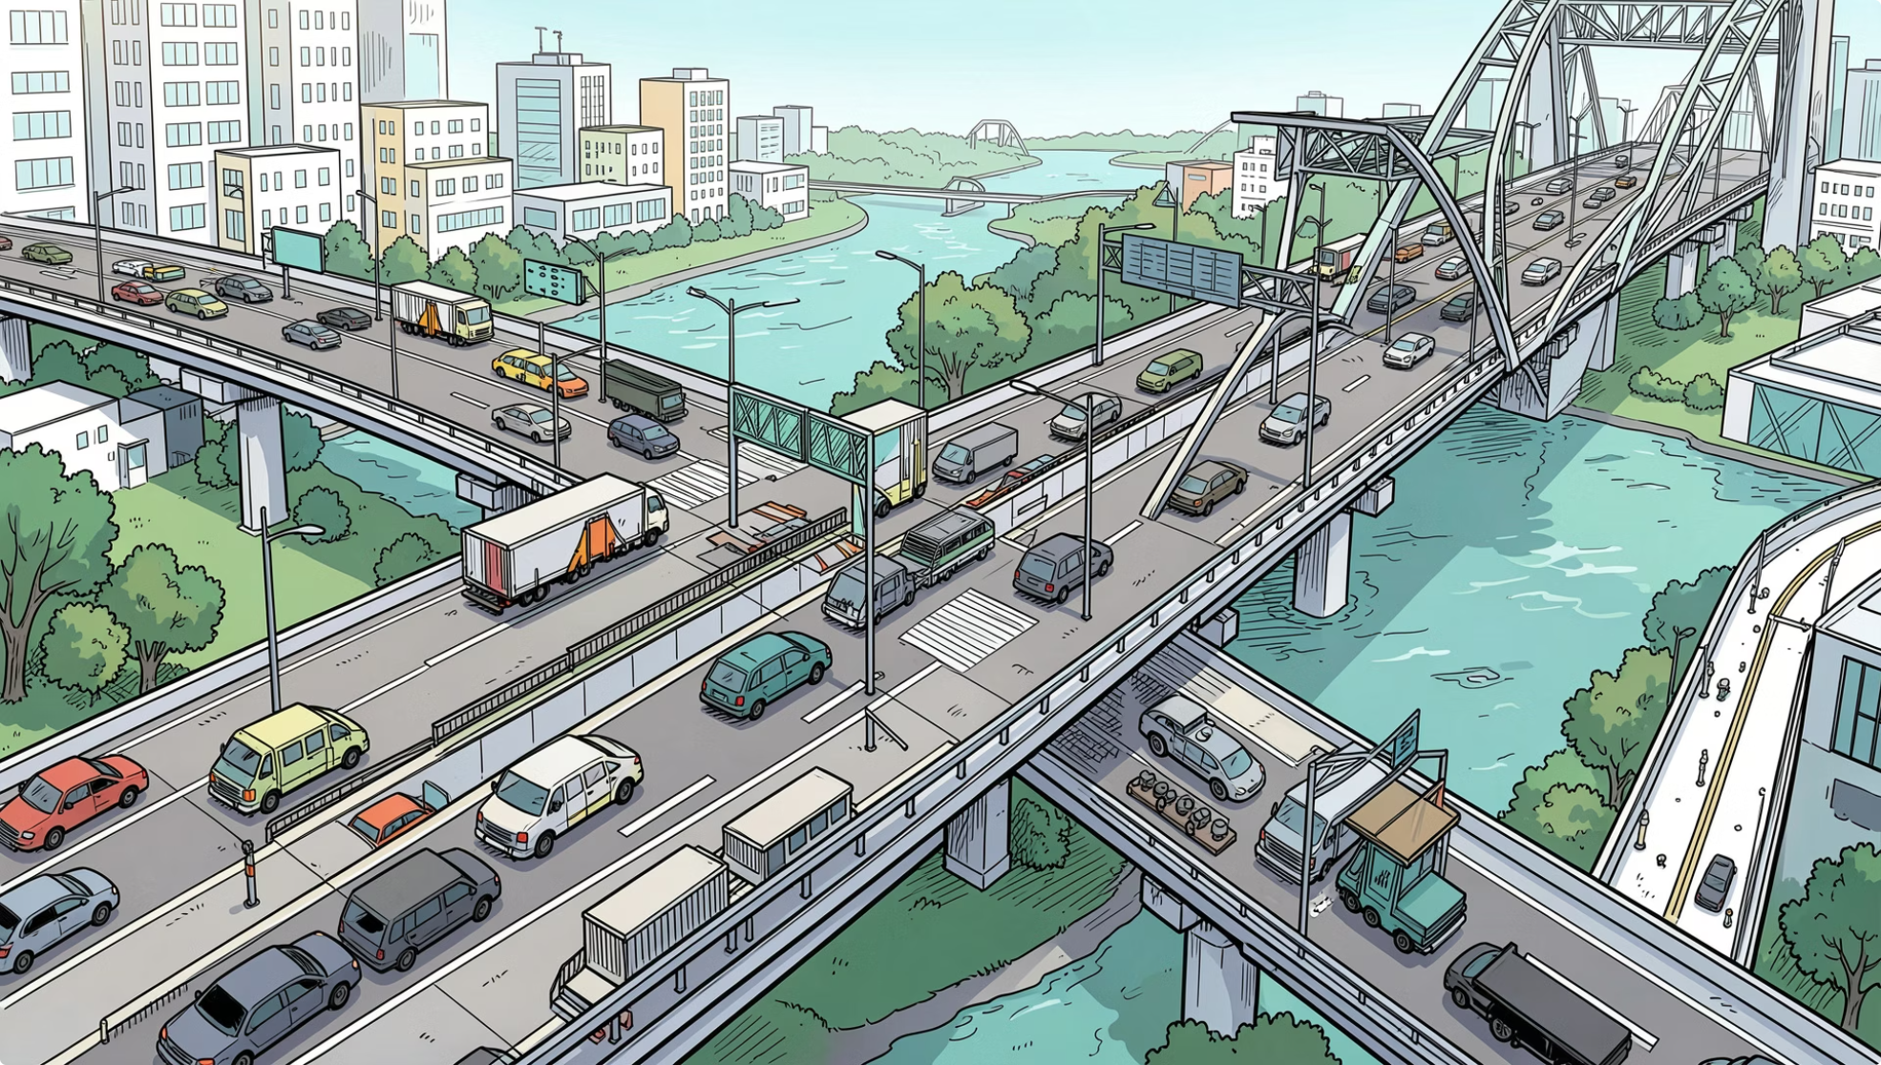
Benefit Theory of Taxation
Core Principle
Taxes are viewed as the price citizens pay for government services. Individuals should contribute in proportion to the benefits they receive from public goods and services.
Practical Examples
Toll taxes on highways and bridges
Municipal property taxes funding local services
User fees for utilities and permits
Key Criticism
Benefits received are often difficult to measure accurately, making fair tax assessment challenging — particularly for public goods like national defense or clean air, which are non-excludable and non-rivalrous.

Slide 10
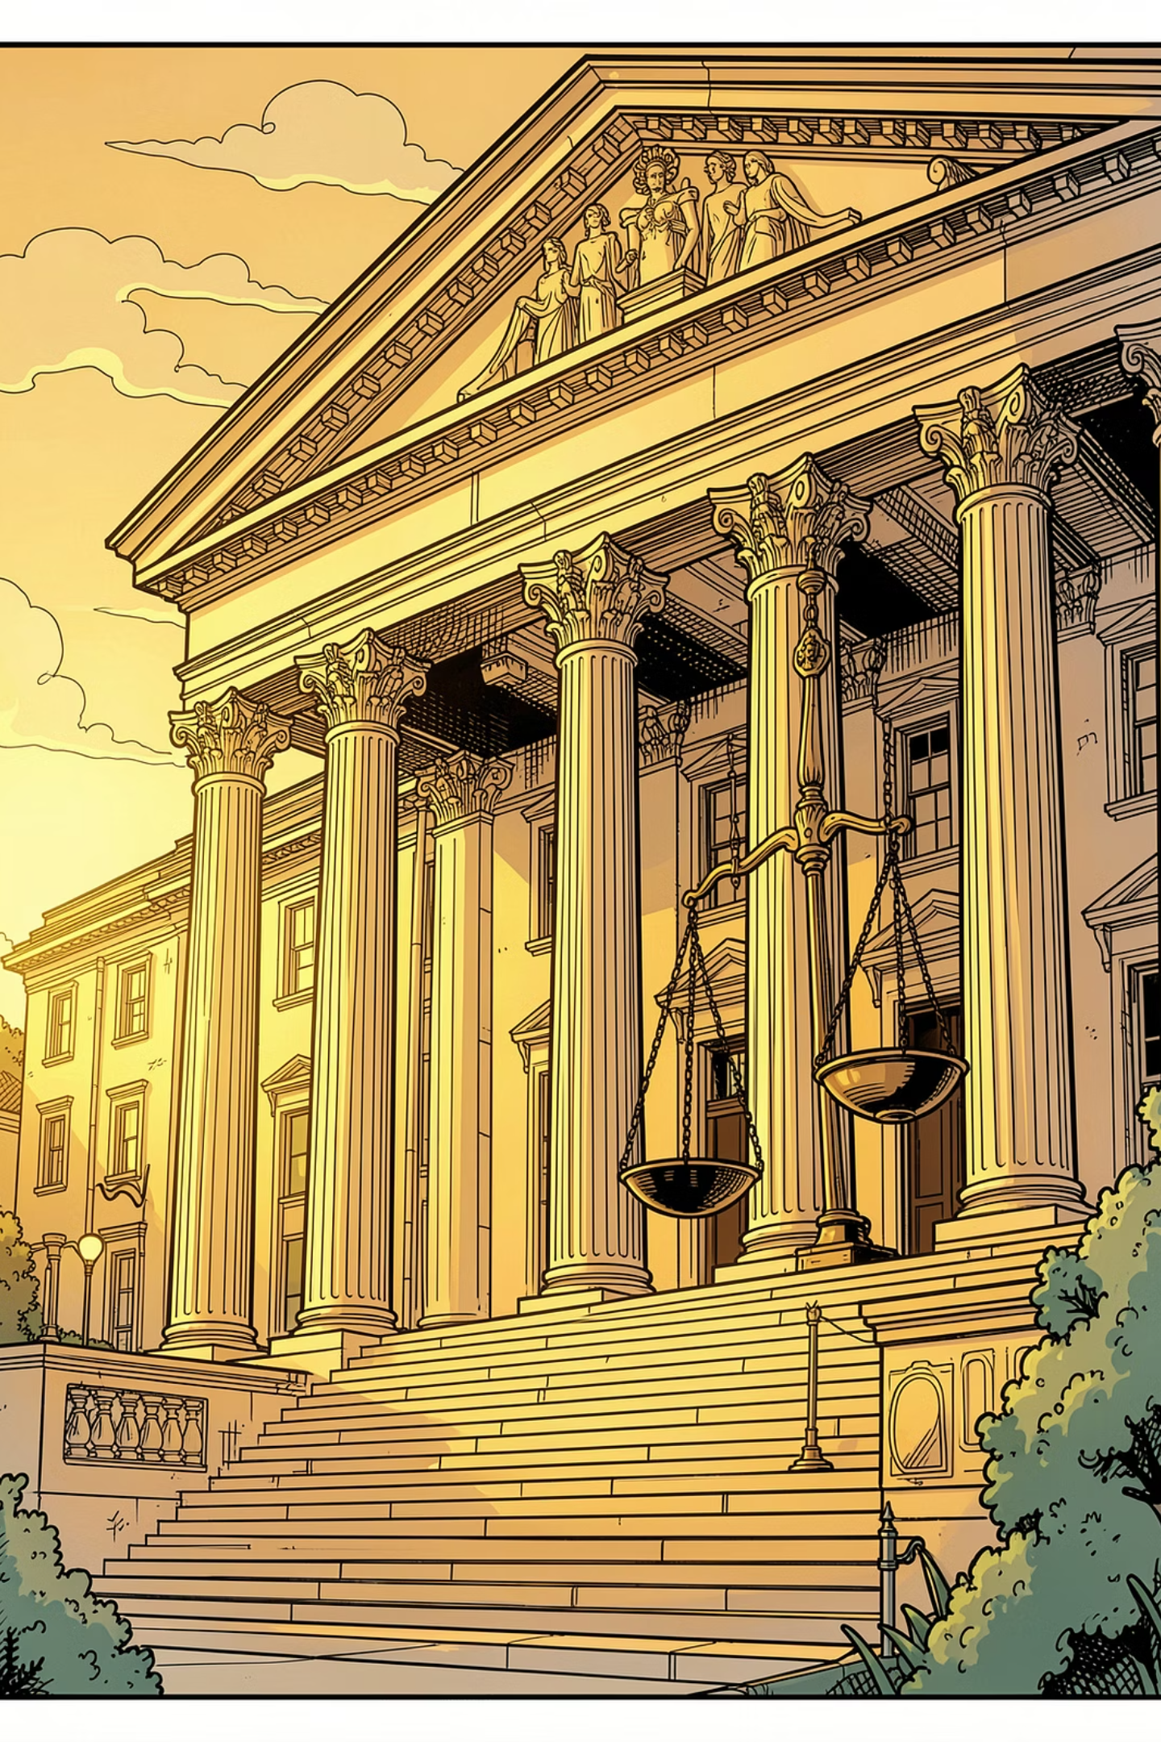

Cost of Service Theory
Taxation as a fee-for-service model: citizens pay in proportion to the government services they receive. Examples include passport fees, court fees, and vehicle registration charges.
Key Criticism: Welfare services like defense, public health, and education cannot be easily monetized or attributed to individual beneficiaries — making universal cost-based taxation impractical.

Slide 11
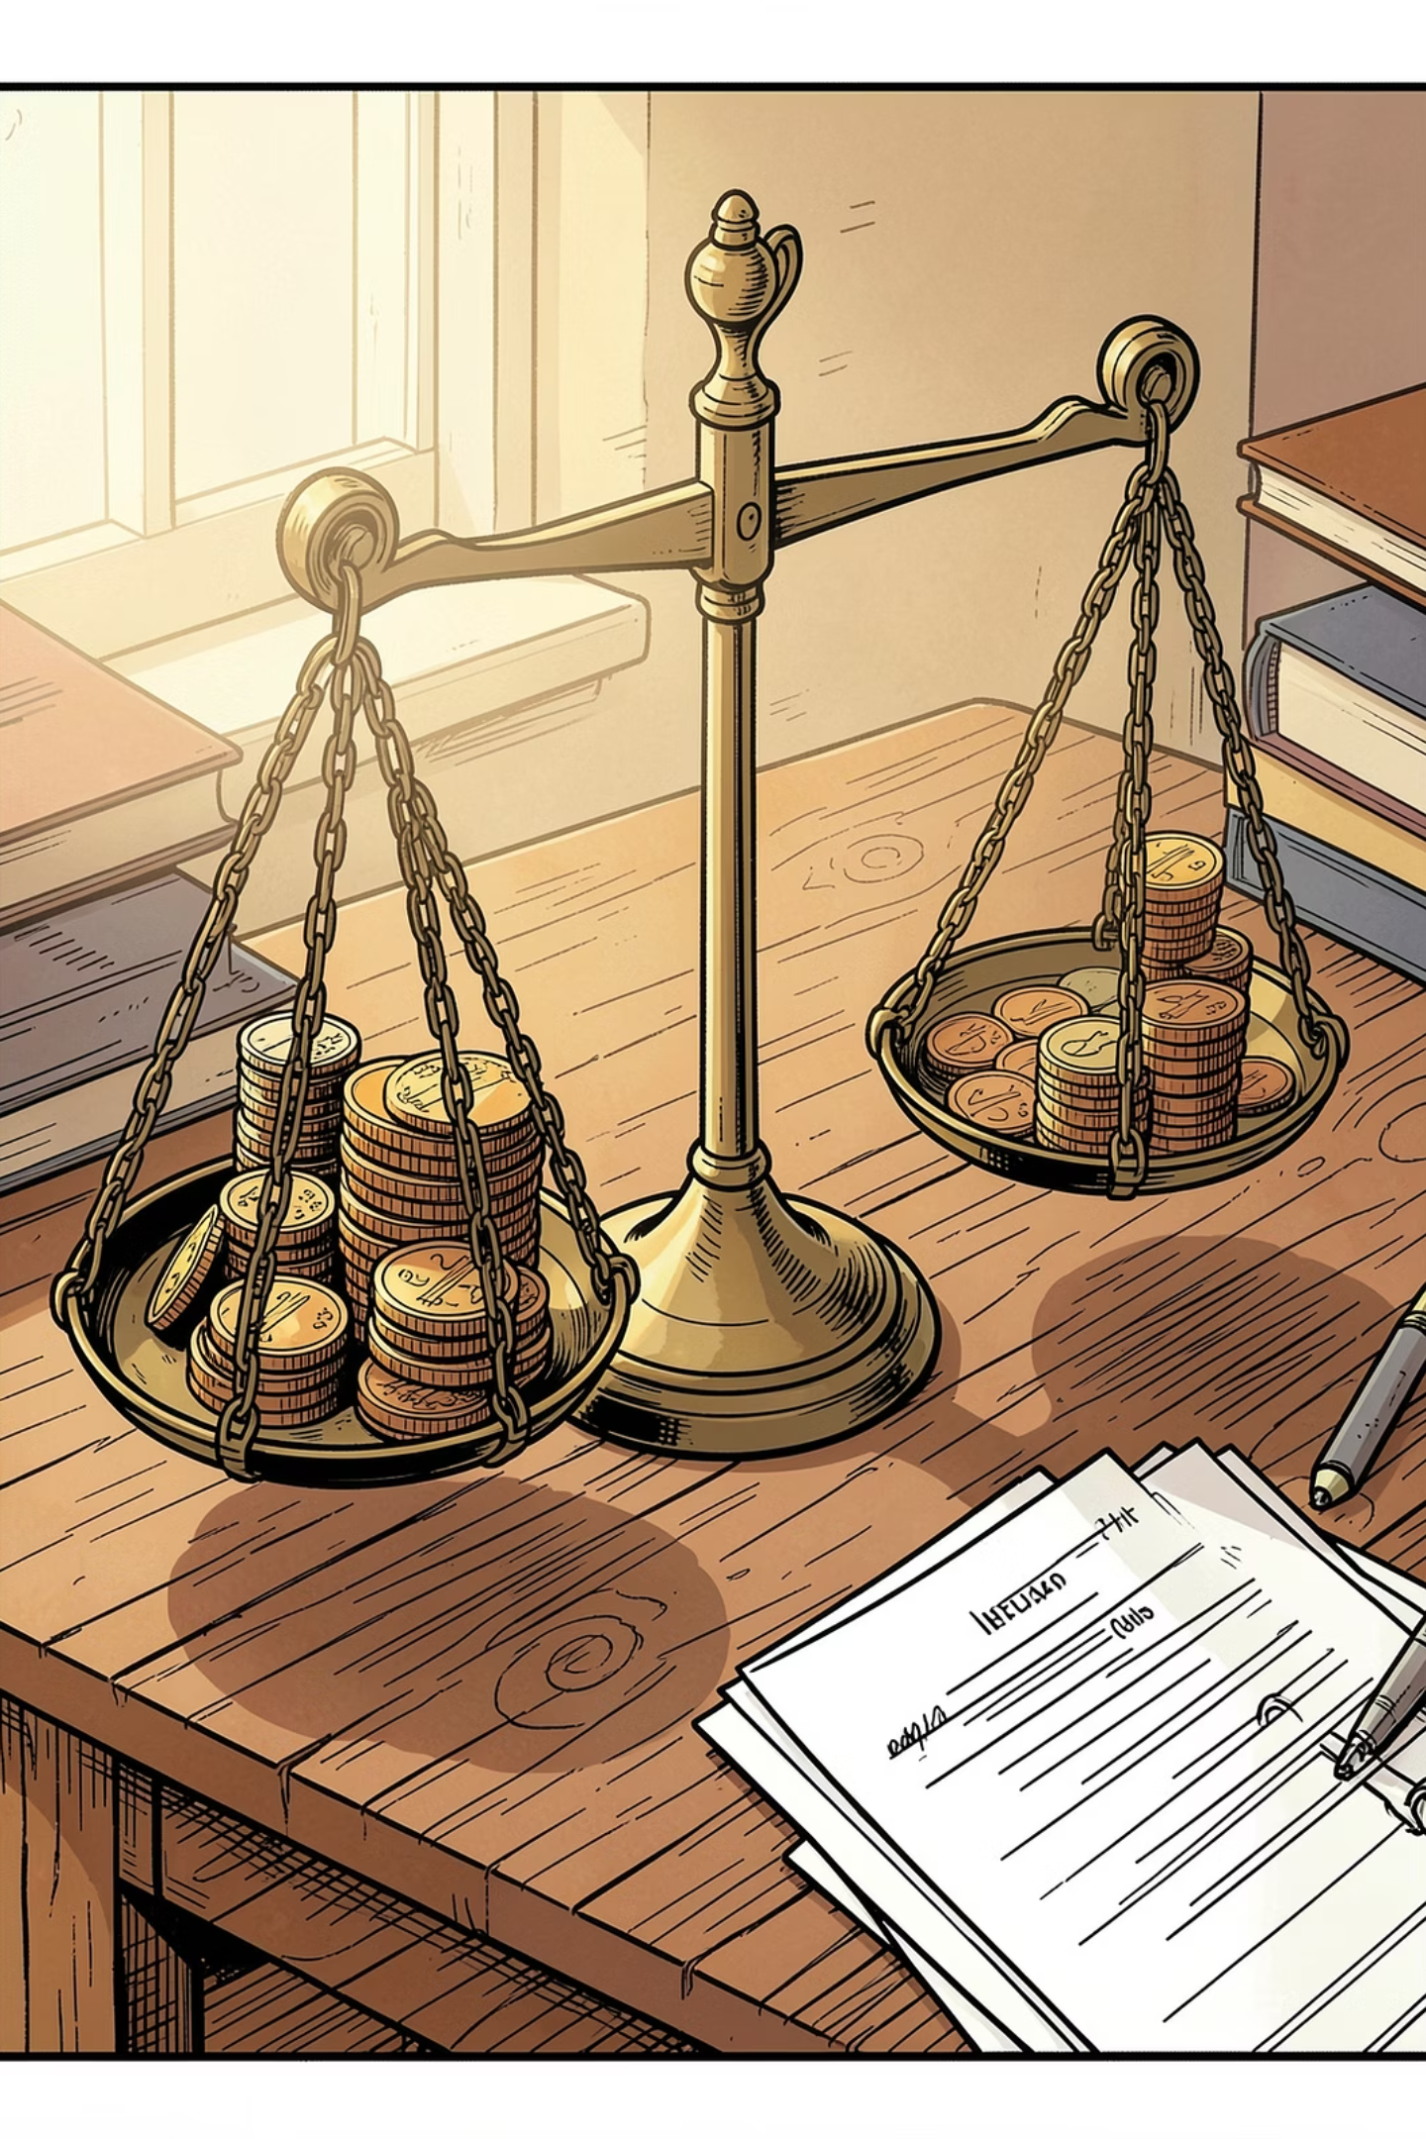
Ability to Pay Theory
Championed by economists John Stuart Mill and A.C. Pigou, this theory holds that taxes should reflect an individual's financial capacity — those with greater means contribute more.
Foundation of Progressivity
Social Justice
Forms the basis of progressive taxation systems used worldwide today.
Reduces economic inequality by distributing the tax burden fairly across income levels.
Practical Application
Income tax brackets are the most direct real-world expression of this principle.

Slide 12
Sacrifice Theory
This theory frames taxation as a shared burden of utility loss — but differs on how that sacrifice should be measured and distributed.
1
2
3
Equal Absolute Sacrifice
Equal Proportional Sacrifice
Equal Marginal Sacrifice
Everyone gives up the same total amount of utility from paying taxes, regardless of income level.
Everyone sacrifices the same proportion of their total utility — meaning wealthier individuals pay more in absolute terms.
The last unit of tax paid causes equal disutility for all — the most widely accepted approach and a strong justification for progressive taxation.

Slide 13
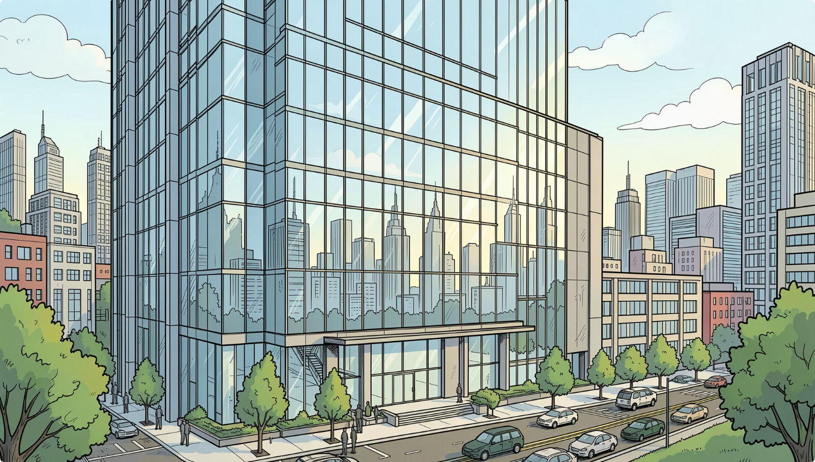
RELATED TO ABILITY TO PAY
Faculty Theory
Faculty Theory bases taxation on an individual's or entity's total economic power — earning capacity, property holdings, and accumulated wealth — not just current income.
Wealthy corporations with substantial assets and high profit margins face higher corporate tax rates, reflecting their greater capacity to contribute to society's needs.

Slide 14




Socio-Political Theory
After World War II, governments shifted toward welfare-oriented taxation — using taxes not just to raise revenue, but to shape social and economic outcomes.
Sin Taxes
Levies on alcohol and tobacco discourage harmful consumption while generating revenue.
Environmental Taxes
Carbon taxes and pollution levies promote sustainability and fund eco-friendly initiatives.
Subsidies
Tax relief on essential goods supports lower-income populations and reduces inequality.

Slide 15

Expediency Theory
A tax system should be practical, simple, and administratively efficient — prioritizing ease of implementation and compliance over theoretical perfection.
GST
TDS
Unified multiple indirect taxes into one streamlined system.
Tax Deducted at Source ensures timely collection at the point of income generation.

Slide 16

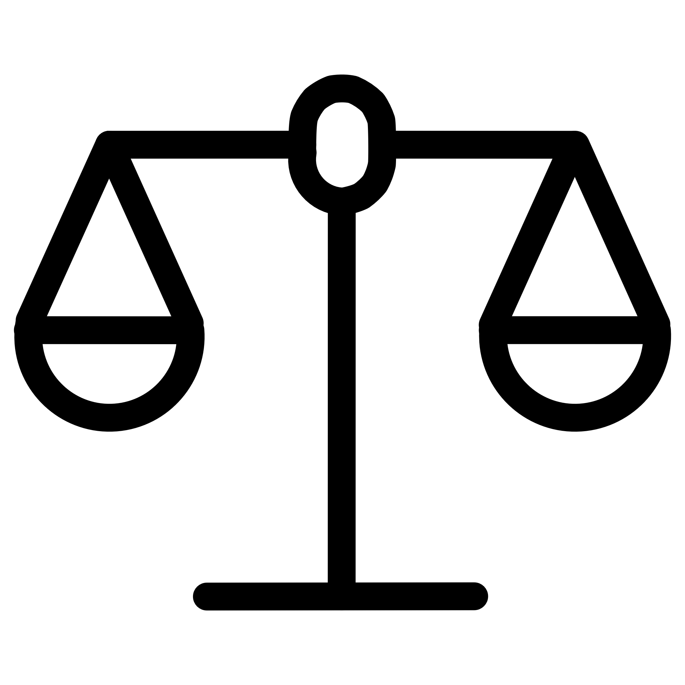


Modern Functions of Taxation
Taxation serves multiple interconnected roles in a modern economy — far beyond simply filling government coffers.
Revenue Function
Redistribution Function
Finances public expenditure: defense, infrastructure, education, and healthcare.
Reduces inequality by redistributing wealth through progressive tax systems.
Economic Stability
Development Function
Controls inflation during booms and manages recessions through fiscal policy adjustments.
Funds national development projects and long-term economic growth initiatives.

Slide 17
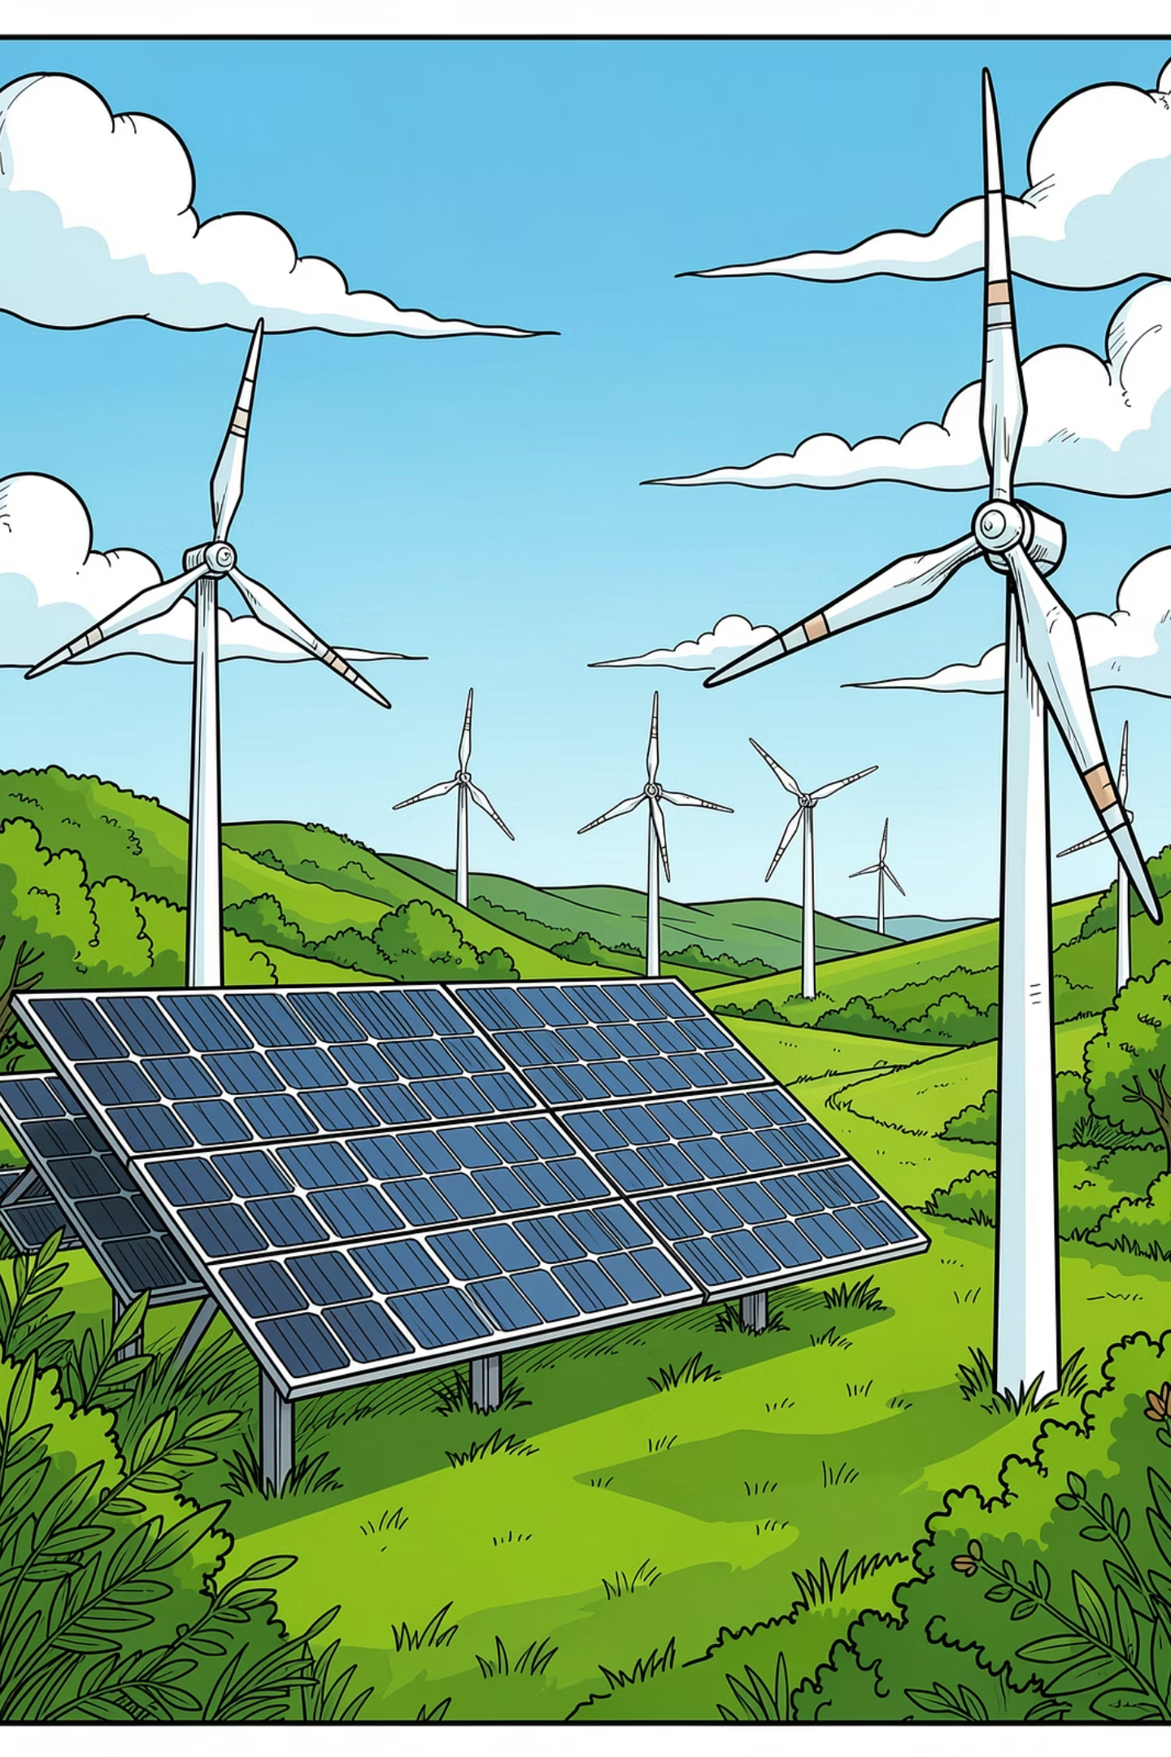
Environmental & Digital Taxation
🌐 Digital Economy
🌿 Green Taxes
Taxing e-commerce platforms and tech giants through mechanisms like the Equalisation Levy (Google Tax) ensures fair contribution from global digital businesses operating across borders.
Carbon taxes and pollution levies incentivize sustainable practices, reduce environmental damage, and fund eco-friendly initiatives for a greener future.

Slide 18
Taxation in India Today
India's tax structure reflects a blend of classical and modern theories, applied across direct and indirect taxation.
Direct Taxes
Indirect Taxes
Income tax and corporate tax follow the Ability to Pay and Sacrifice Theories — ensuring progressive, equitable contribution based on financial capacity.
GST and customs duties align with Benefit and Expediency Theories. GST's "One Nation, One Tax" model simplified India's tax structure, reducing cascading effects and improving transparency.

Slide 19
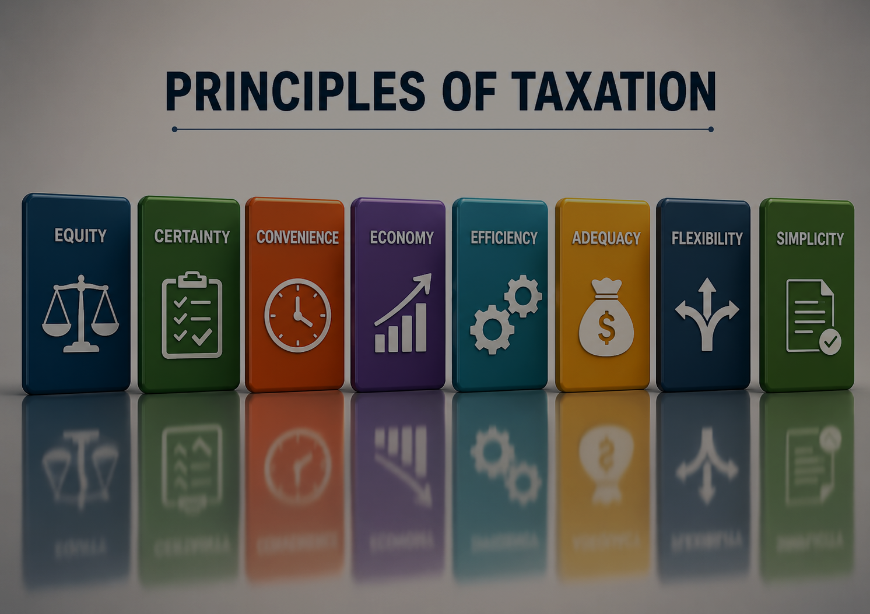
A study of the fundamental guidelines that shape fair, efficient, and effective tax systems —
from Adam Smith's classical canons to modern principles.

Slide 20

Meaning of Principles of Taxation
Principles of taxation are the fundamental guidelines that help governments design an effective, fair, and efficient tax system.
Equity
Fair distribution of tax burden
Convenience
Easy for taxpayers to comply
Efficiency
Low administrative cost
Stability
Supports economic stability

Slide 21
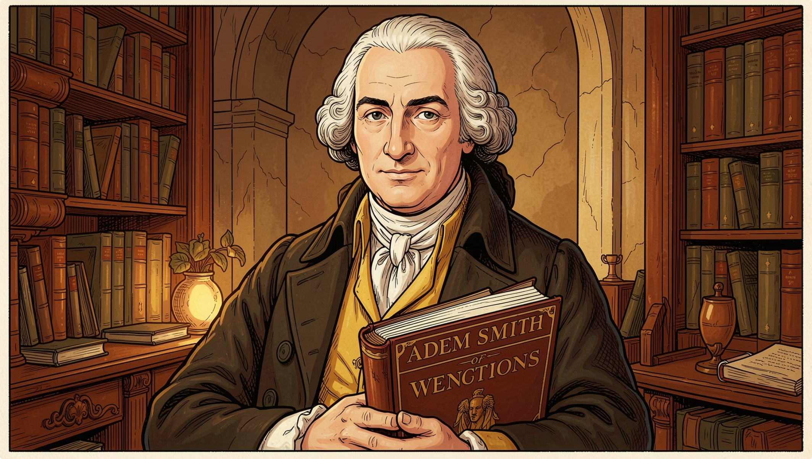
Historical Background: Adam Smith
The Wealth of Nations (1776)
Adam Smith introduced the modern principles of taxation in his landmark book, proposing four foundational canons that still guide tax policy today.
1
2
3
4
Canon of Equality
Canon of Certainty
Canon of Convenience
Canon of Economy

Slide 22
Canon of Equality & Certainty
Canon of Equality
Canon of Certainty
Every citizen contributes according to their ability to pay. Richer individuals pay more taxes, promoting social justice and reducing inequality.
Example: Progressive income tax in India — higher income groups pay higher rates.
Tax amount, time, and method must be clear and non-arbitrary. Taxpayers should know exactly how much, when, and how to pay.
Example: Income tax slabs and GST rates announced by the government.
Importance: Reduces corruption and builds trust in tax administration.

Slide 23

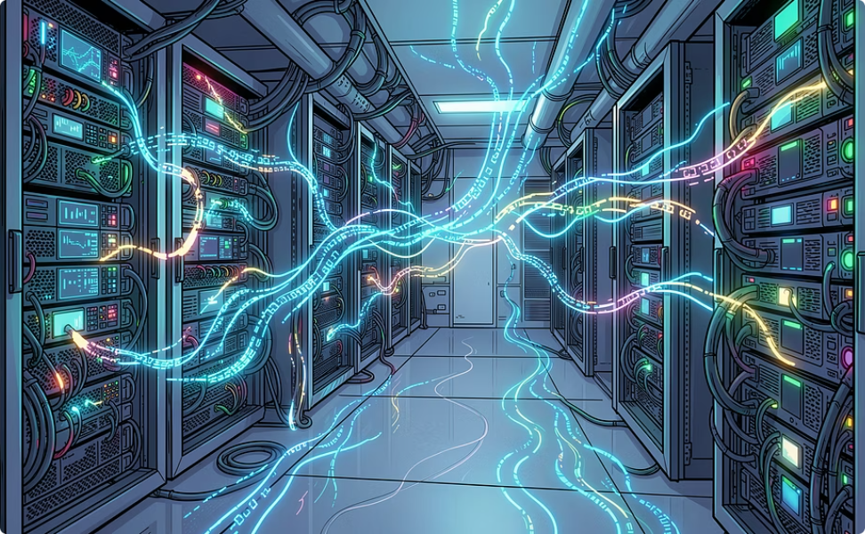
Canon of Convenience & Economy
Canon of Convenience
Canon of Economy
Taxes should be collected at a convenient time and manner for taxpayers.
The cost of tax collection should be minimal compared to revenue collected.
TDS deducted directly from salary
Online tax filing systems
Easy compliance → better collection
Digital tax systems reduce costs
Efficient administration
Avoids wastage of public money

Slide 24





Additional Modern Principles
Modern economists expanded Smith's canons with five new principles to improve the traditional taxation system.
Productivity
Elasticity
Simplicity
Tax system must generate sufficient revenue for public expenditure. Example: GST is a major revenue source in India.
Tax revenue should increase automatically with economic growth. Example: Income tax rises with national income.
Tax system should be simple and easy to understand. Example: Online GST portal and simplified returns.
Diversity
Flexibility
Government should impose different types of taxes (direct & indirect) instead of depending on a single source.
Tax structure should adjust to changing economic conditions. Example: Tax cuts during recession to stimulate demand.

Slide 25
Modern Principles & Indian Tax System
Modern Tax Systems Focus On
Principles Reflected in India
Equity & Efficiency
Progressive Income Tax
GST System
→ Simplicity & Convenience
Transparency & Digitalization
→ Equality
Economic Growth & Sustainability
Online Filing
Tax Reforms
→ Economy & Efficiency
→ Flexibility

Slide 26

Advantages & Challenges
Advantages of Good Tax Principles
Limitations & Challenges
Increases government revenue
Promotes economic welfare
Reduces tax evasion
Ensures fairness
Encourages national development
Tax evasion
Complex procedures
Corruption
Inequality in application
Digital divide
Need: Continuous tax reforms and modernization are essential.

Slide 27

Conclusion
Principles of taxation are essential for developing a fair, efficient, and productive tax system. From Adam Smith's classical canons to modern principles, governments aim to balance revenue collection with economic growth and social justice.
Fair
Simple
Economical
National Welfare
A good tax system should be fair, simple, economical, and promote national welfare.

Slide 28
Thank You
Questions & Discussion Welcome

