Slide 1

Emerging Research Issues in Corporate Governance
By
Dr. Anoop Patel
Assistant Professor
Department of Commerce
S D College, Muzaffarnagar

Slide 2
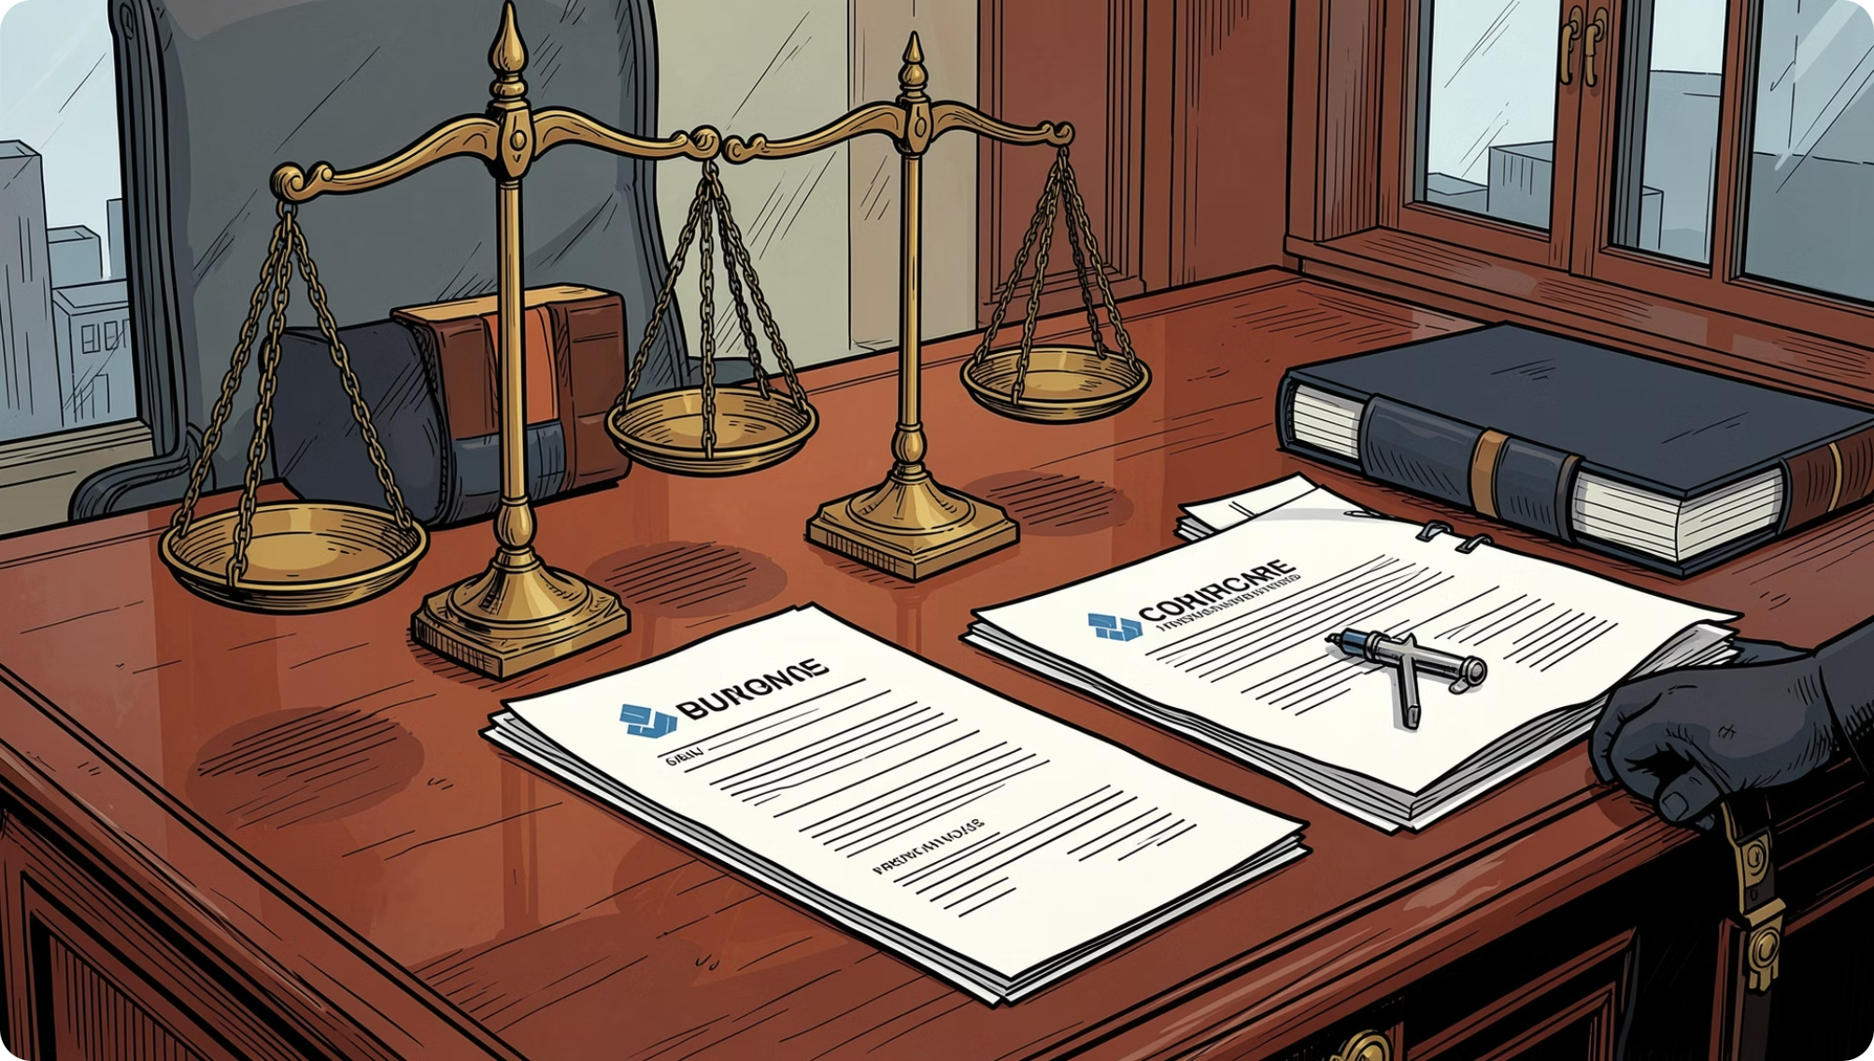

What Is Corporate Governance?
Corporate governance refers to the system of principles, rules, and processes by which companies are directed and controlled. It establishes the framework through which corporate objectives are set and performance is monitored.
Management–Shareholder Relations
Ethical & Transparent Conduct
Defines accountability between those who run and those who own the firm.
Ensures integrity in decision-making and disclosure practices.

Slide 3
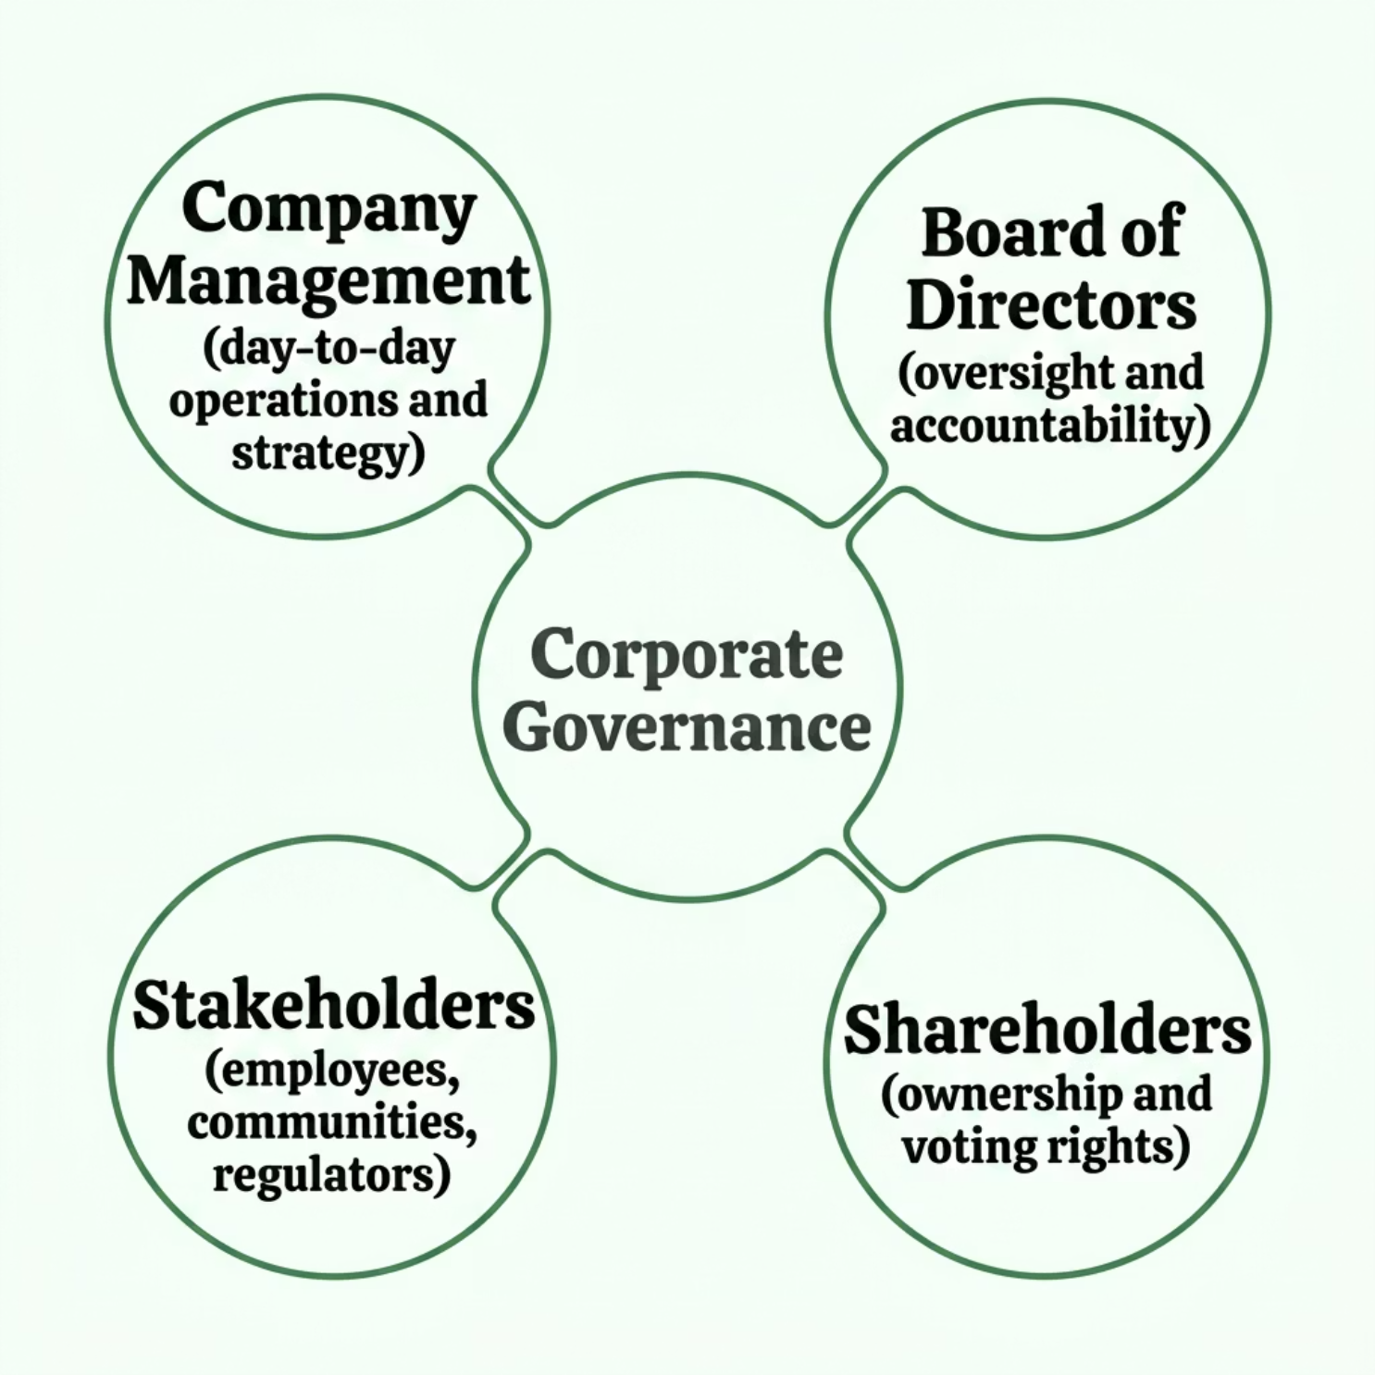

Defining Corporate Governance: The OECD Framework
"Corporate governance involves a set of relationships between a company's management, its board, its shareholders, and other stakeholders." — OECD Principles of Corporate Governance
The OECD definition is the most widely cited in academic and policy literature. It emphasizes that governance extends beyond shareholders to encompass employees, creditors, regulators, and communities.

Slide 4






Core Objectives of Corporate Governance
Accountability
Transparency
Management answerable to boards, shareholders, and regulators.
Timely, accurate disclosure of financial and operational information.
Fairness
Shareholder Protection
Equitable treatment of all shareholders, including minorities.
Safeguarding ownership rights and enabling effective participation.
Ethical Management
Long-Term Sustainability
Upholding integrity, compliance, and responsible conduct.
Balancing short-term performance with enduring value creation.

Slide 5
The Evolution of Corporate Governance
Early Stage
1
Focus on ownership structures and profit maximization. Governance was informal and owner-centric.
2
1980s–1990s
Rise of shareholder activism. Agency theory (Jensen & Meckling, 1976) framed the principal–agent problem.
Post-2000 Era
3
High-profile scandals triggered global regulatory reforms emphasizing ethics, compliance, and board independence.
4
Present Day
ESG integration, stakeholder capitalism, AI governance, and digital accountability dominate the agenda.

Slide 6
Landmark Corporate Governance Failures
These scandals exposed systemic weaknesses and catalyzed regulatory reform worldwide.
Company
Country
Governance Failure
Enron
USA
Off-balance-sheet entities concealed massive debt; auditor collusion (Arthur Andersen).
WorldCom
USA
$11bn accounting fraud via improper capitalization of expenses.
Satyam
India
₹7,000 crore inflation of cash balances; falsified accounts over years.
IL&FS
India
Debt concealment and poor risk management triggered India's NBFC crisis.
Yes Bank
India
Evergreening of bad loans; weak board oversight of concentrated lending.

Slide 7



CASE STUDY
The Satyam Scam: Anatomy of a Governance Collapse
What Happened?
In January 2009, Satyam founder Ramalinga Raju confessed to inflating revenues, profits, and cash balances by approximately ₹7,000 crore over several years — one of India's largest corporate frauds.
Research Angle: How did cultural norms and promoter-dominated boards in Indian IT firms enable such prolonged fraud?
Governance Failures
Regulatory Impact
Board lacked independence; auditors (PwC) failed to detect falsifications; related-party transactions went unchallenged.
Strengthened Clause 49 of the Listing Agreement; SEBI mandated stricter auditor rotation and enhanced independent director requirements.

Slide 8

ESG Governance: An Emerging Focus
Investors increasingly evaluate companies not just on financial returns, but on sustainability, environmental responsibility, and social impact. ESG governance has become a critical lens for modern investment decisions.
ENVIRONMENTAL · SOCIAL · GOVERNANCE

Slide 9


ESG by the Numbers
Global ESG Market
ESG assets are expected to exceed USD 40 trillion globally, reflecting the rapid growth of sustainable investing worldwide.
India: SEBI & BRSR
SEBI introduced the Business Responsibility and Sustainability Reporting (BRSR) framework — now mandatory for top listed companies in India, aligning disclosure with global ESG standards.

Slide 10

Key Research Questions
1
2
Firm Performance
Risk Reduction
Does strong ESG performance translate into improved financial outcomes for firms?
Does comprehensive ESG reporting meaningfully reduce operational and reputational risk?
3
Investor Decisions
How does ESG disclosure influence capital allocation and investor confidence?

Slide 11



Board Diversity & Inclusion
Research increasingly focuses on how board composition shapes governance quality and strategic outcomes.
Gender Diversity
Independent Directors
Skill Diversity
Representation of women on boards and its correlation with governance effectiveness.
The role of non-executive directors in ensuring objective oversight and accountability.
How varied professional backgrounds on boards enhance strategic decision-making.

Slide 12


INDIA · COMPANIES ACT 2013
Mandatory Woman Director
Under the Companies Act 2013, certain listed companies in India are required to appoint at least one woman director to their board.
This landmark provision was among the first regulatory mandates globally to enforce gender representation at the board level, setting a precedent for inclusive governance.

Slide 13

Board Diversity: Research Areas
Governance Quality
Profitability Impact
Innovation Link
Does gender diversity on boards measurably improve governance standards and reduce agency problems?
What is the empirical relationship between female director representation and firm profitability metrics?
Does a more diverse board foster greater innovation, R&D investment, and long-term competitive advantage?

Slide 14

Artificial Intelligence & Corporate Governance
NEW GOVERNANCE CHALLENGES
Ethical Decision-Making
AI systems must align with corporate values and ethical frameworks.
Algorithmic Bias
Bias in automated systems can perpetuate discrimination and regulatory risk.
Data Privacy
AI-driven data handling raises critical privacy and compliance concerns.
Accountability
Determining liability when AI-driven decisions cause harm remains unresolved.

Slide 15
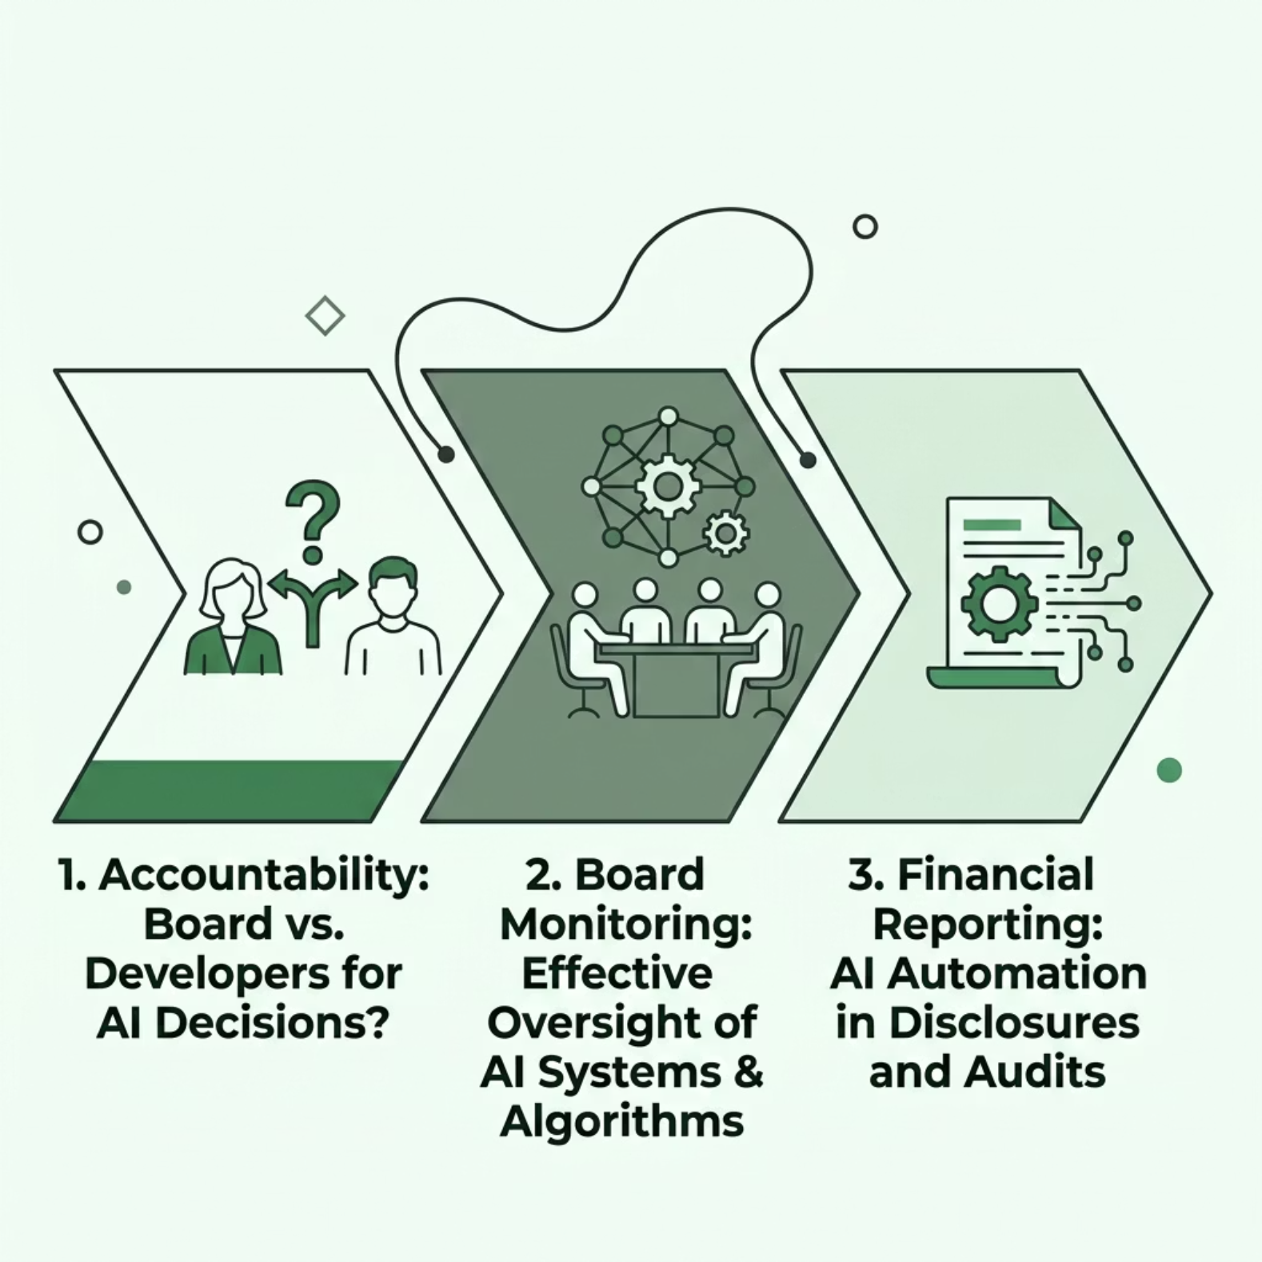
AI Governance: Research Issues
Core Research Questions
Accountability: Who bears responsibility when AI systems make flawed or harmful decisions — the board, management, or developers?
Board Monitoring: How can boards develop the capability to effectively oversee AI-driven operations and risk?
Financial Reporting: What governance frameworks are needed for AI-generated financial disclosures and audit trails?

Slide 16




Cybersecurity Governance
EMERGING CONCERN
Cyber threats have elevated cybersecurity from an IT issue to a board-level governance priority. Companies must address:
Cyberattacks
Ransomware
Targeted attacks on corporate infrastructure and critical systems.
Malicious encryption of data demanding payment for release.
Data Breaches
Unauthorized access to sensitive corporate and customer information.

Slide 17


Key Takeaways
Global Impact
Major companies globally have lost billions due to cyber incidents, underscoring the critical importance of robust cybersecurity governance frameworks.
Looking Ahead
ESG governance, board diversity, AI accountability, and cybersecurity represent the frontier issues shaping the future of corporate governance research and practice — in India and globally.
These interconnected themes demand interdisciplinary research and proactive regulatory frameworks.

